Slide 1
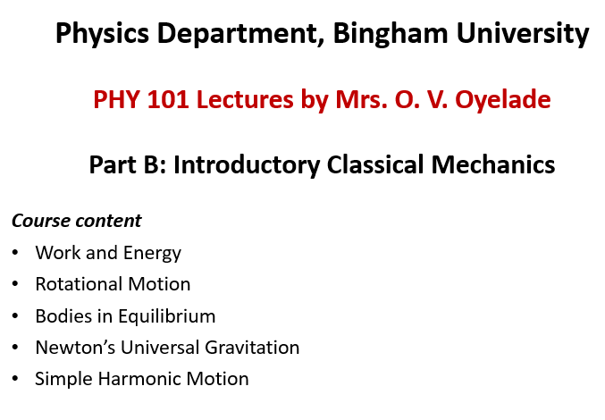

Slide 2
Newton’s Law of Universal Gravitation

Slide 3
Newton's Law of Universal Gravitation
Learning Objectives
•To calculate the gravitational force between two point masses
• To explain the connection between the constants G and g
• To determine the mass of an astronomical body from free-fall acceleration at its surface • To describe how the value of g varies due to location and Earth’s rotation • To determine escape velocity • To use Kepler’s laws in calculation

Slide 4
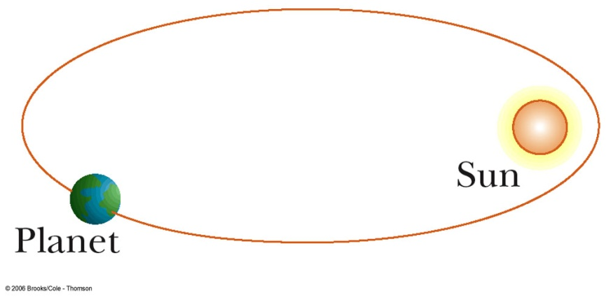
Newton’s Law of Universal Gravitation
The apple was attracted to the Earth
All objects in the Universe were attracted
to each other in the same way the apple was
attracted to the Earth

Slide 5
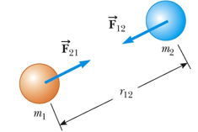


Newton’s Law of Universal Gravitation
Every particle in the Universe attracts every other particle with a force that is directly proportional to the product of the masses and inversely proportional to the square of the distance between them.
the vector points from object 1 toward object 2, and hence represents an attractive force between the objects. The equal but opposite force is the force on object 2 exerted by object 1.

Slide 6
Newton’s Law of Universal Gravitation
G is the constant of universal gravitation
G = 6.673 x 10⁻¹¹ N m² /kg²
This is an example of an inverse square law
Determined experimentally by Henry Cavendish in 1798
The value of G is very small (weak) and same everywhere, its attractive nature is what holds us to Earth, causes the planets to orbit the Sun and the Sun to orbit our galaxy. Gravity is the force that forms the Universe.

Slide 7
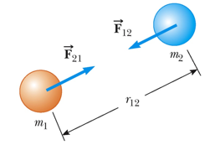
Newton’s Law of Universal Gravitation
The force that mass 1 exerts on mass 2 is equal and opposite to the force mass 2 exerts on mass 1
The forces form Newton’s third law of action-reaction
The gravitational force exerted by a uniform sphere on a particle outside the sphere is the same as the force exerted if the entire mass of the sphere were concentrated on its center

Slide 8



Example
Two masses of 9000 kg each are 10.0 m from center to center. Determine the gravitational force between them.
Solution

Slide 9
Free-Fall Acceleration
Have you heard this claim:
Astronauts are weightless in space, therefore there is no gravity in space?
It is true that if an astronaut on the International Space Station (ISS) tries to step on a scale, he/she will weigh nothing.
It may seem reasonable to think that if weight = mg, since weight = 0, g = 0, but this is NOT true.
If you stand on a scale in an elevator and then the cables are cut, you will also weigh nothing (ma = N – mg, but in free-fall a = g, so the normal force N = 0). This does not mean g = 0!
Astronauts in orbit are in free-fall around the Earth, just as you would be in the elevator. They do not fall to Earth, only because of their very high tangential speed.

Slide 10
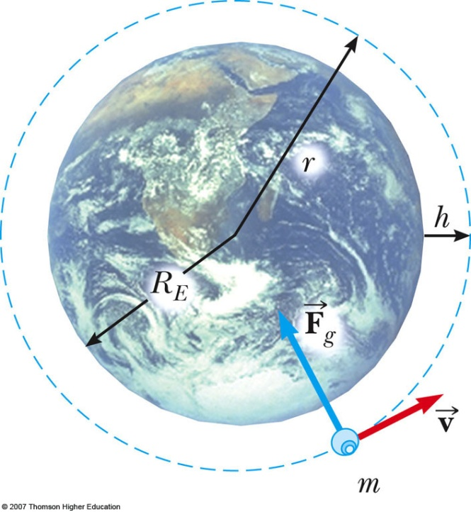

Free-Fall Acceleration and the Gravitational Force
the acceleration of a free-falling object near Earth’s surface is ~ g = 9.80 m/s2 The force causing this acceleration is called the weight (mg) of the object
Consider an object of mass m near the Earth’s surface
Acceleration a_{g} due to gravity
at the Earth’s surface

Slide 11
Free-Fall Acceleration and the Gravitational Force
Consider an object of mass m at a height h above the Earth’s surface
Acceleration a_{g} due to gravity
a_{g} will vary with altitude

Slide 12




Example
a) Find the mass of Earth. b) Estimate the value of g on the Moon. Use the fact that the Moon has a radius of about 1700 km and assume it has the same average density as Earth, 5500 kg/m³ . a)
b) The volume of a sphere is proportional to the radius cubed, so a simple ratio gives us
:.

Slide 13



Example
What is the value of g 400 km above Earth’s surface, where the International Space Station is in orbit?
Solution
Using the value of M_{E} and noting the radius is r = R_{E} + 400 km
Note: The astronauts in the International Space Station still have 88% of their weight. They only appear to be weightless because they are in free fall.

Slide 14
Apparent Weight
Objects moving at constant speed in a circle have a centripetal acceleration directed toward the center of the circle, meaning a net force is directed toward the center of that circle.
There must be a net centripetal force on each object directed toward the center of that circle.
An object of mass m located at the equator, suspended from a scale. The scale exerts an upward force F_{s} away from Earth’s center. This is the reading on the scale, it is the apparent weight of the object.
The weight (mg) points toward Earth’s center. If Earth were not rotating, the acceleration would be zero and, consequently, the net force would be zero, resulting in Fs = mg . This would be the true reading of the weight.

Slide 15

Apparent Weight
With rotation, the sum of these forces must provide the centripetal acceleration, ac .
Using Newton’s second law,
But v = rω . Hence, a_{c} = - rw² and r = R_{E} The apparent weight at the equator is
At the poles, ac → 0 and Fs = mg , just as is the case without rotation.

Slide 16
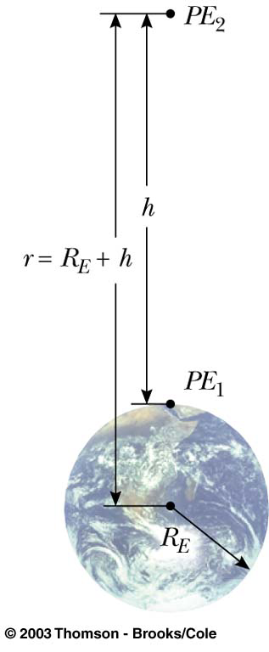
Gravitational Potential Energy
the change in gravitational potential energy near Earth’s
surface is ΔU = mgy is valid only near the earth’s surface
For objects high above the earth’s surface, an alternate
expression is needed
Zero reference level is infinitely far from the earth,
so potential energy is everywhere negative!
Energy conservation

Slide 17
Energy of an Orbit
Consider a circular orbit of a planet around the Sun. What keeps the planet moving in its circle?
It is the centripetal force produced by the gravitational force, i.e.
That implies that
Making this substitution in the expression for total energy:
Note the total energy is negative, and is half the (negative) potential energy.
For an elliptical orbit, r is replaced by a:

Slide 18
Escape Speed
The escape speed is the speed needed for an object to soar off into space and not return
For the earth, v_{esc} is about 11.2 km/s
Note, v is independent of the mass of the object

Slide 19
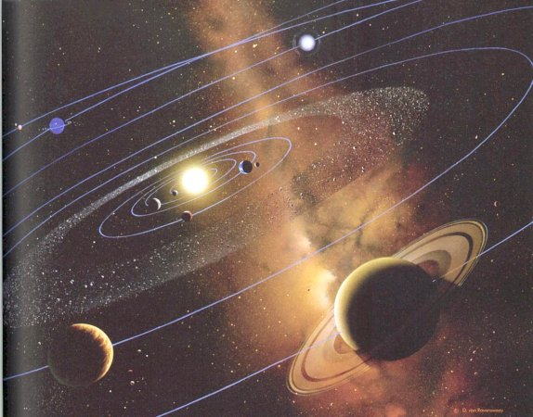
Kepler’s Laws
All planets move in elliptical orbits
with the Sun at one of the focal points.
A line drawn from the Sun to any
planet sweeps out equal areas in
equal time intervals.
The square of the orbital period of any
planet is proportional to cube of the
average distance from the Sun to the
planet.

Slide 20
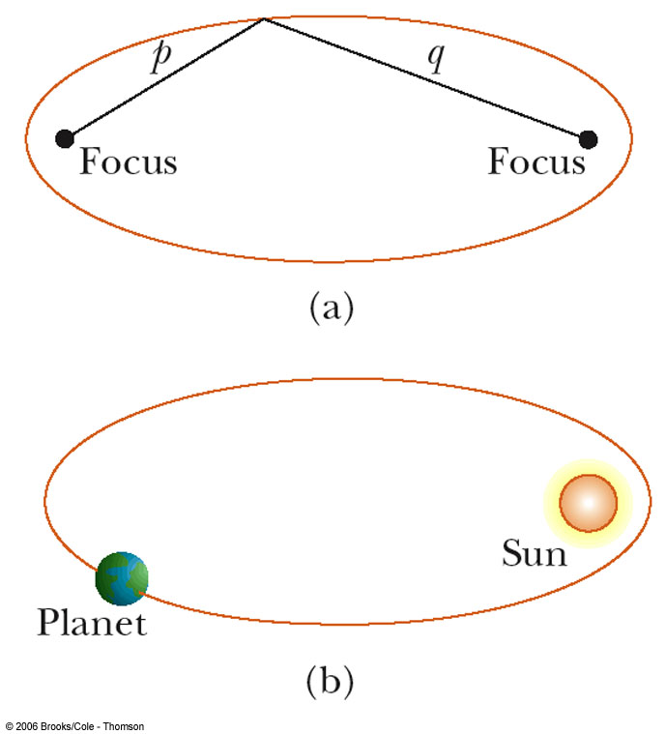
Kepler’s First Law
All planets move in elliptical orbits
with the Sun at one focus.
Any object bound to another by an inverse
square law will move in an elliptical path
Second focus is empty

Slide 21
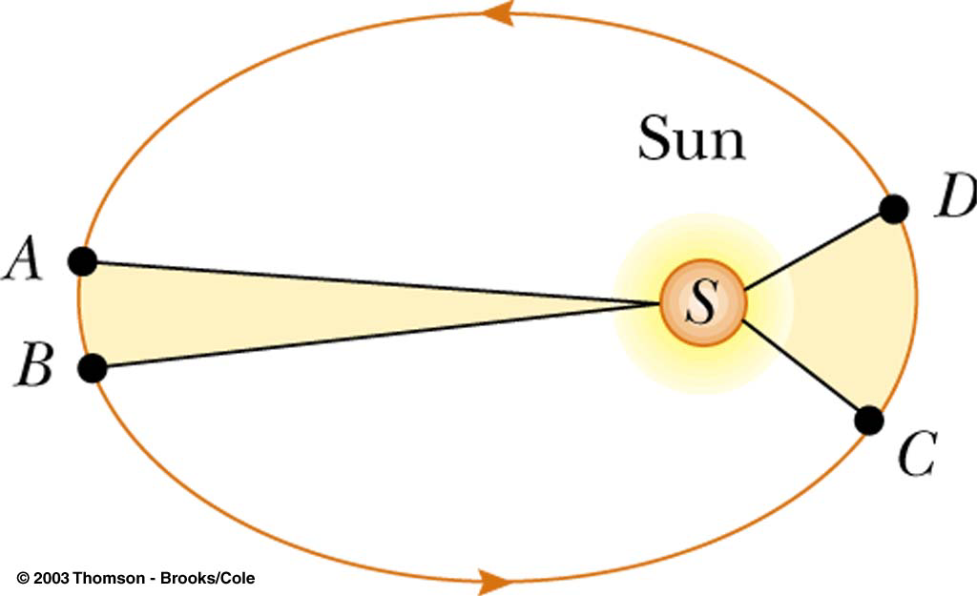
Kepler’s Second Law
A line drawn from the Sun to any
planet will sweep out equal areas in
equal times
Area from A to B and C to D are the same

Slide 22
Kepler’s Third Law
The square of the orbital period of any planet is proportional to cube of the average distance from the Sun to the planet.
T is the period of the planet
a is the average distance from the Sun. Or a is the length of the semi-major axis
For orbit around the Sun, K = K_{S} = 2.97x10⁻¹⁹ s²/m³
K is independent of the mass of the planet

Slide 23
Example
Calculate the mass of the Sun noting that the period of the Earth’s orbit around the Sun is 3.156 x 10⁷ s and its distance from the Sun is 1.496 x 10¹¹ m.

Slide 24
Example
From a telecommunications point of view, it’s advantageous for satellites to remain at the same location relative to a location on the Earth. This can occur only if the satellite’s orbital period is the same as the Earth’s period of rotation, 24 h. (a) At what distance from the center of the Earth can this geosynchronous orbit be found? (b) What’s the orbital speed of the satellite?
a)
b)

Slide 25
Exercises
Ex. 13 nos: 14, 21, 25, 33 and 47.

Slide 26
References
University Physics Volume 1
L. Samuel @ 2016 OpenStax College
Physics: Principles with Applications
C. Giancoli @ 2014, Pearson, ISBN- 13:9780321625922
Physics at New Jersey Science & Technology University

